Slide 1

Bond Measure “S”
Original $356,347,814
Interest: $24,374,131
TOTAL: $388,721,945
Ventura Community College District

Slide 2
Bond Allocation

Slide 3
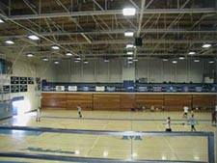
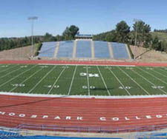
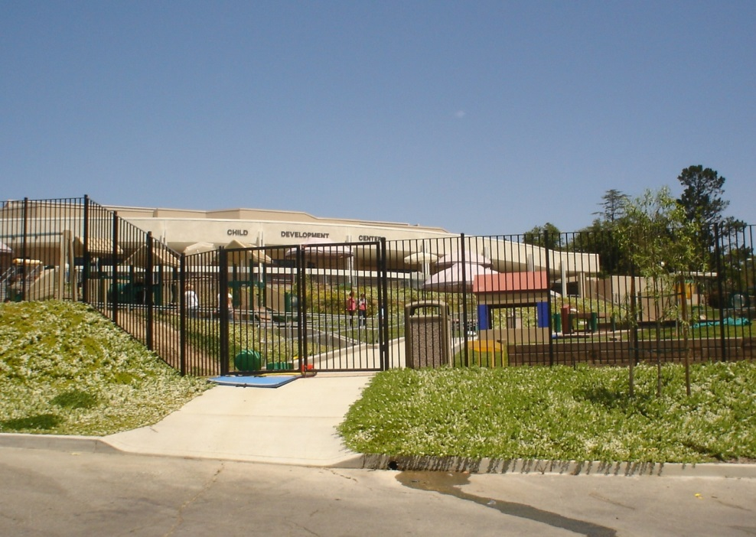
Moorpark College
PE Facilities Renovation
Budget $1.16 million
Completed 2007
Athletics Field
Budget $3.2 million
Completed 2005
Child Development Center
Budget $5.6 million
Completed 2006

Slide 4
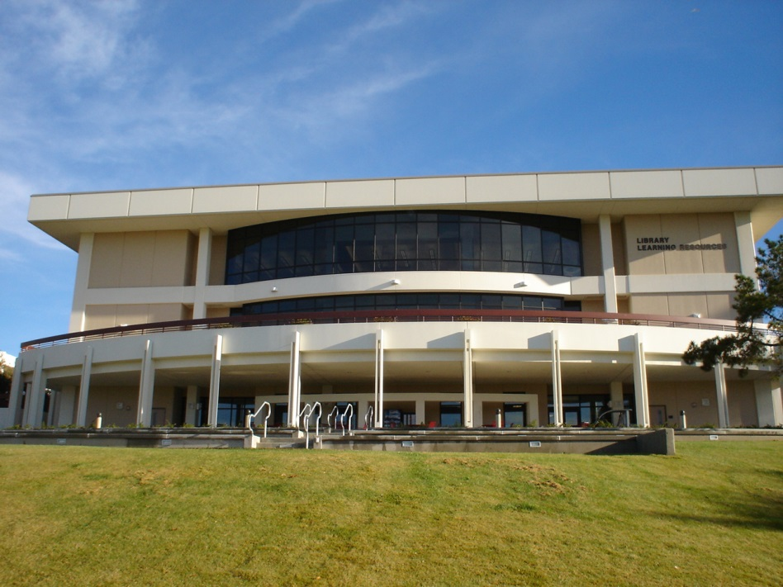
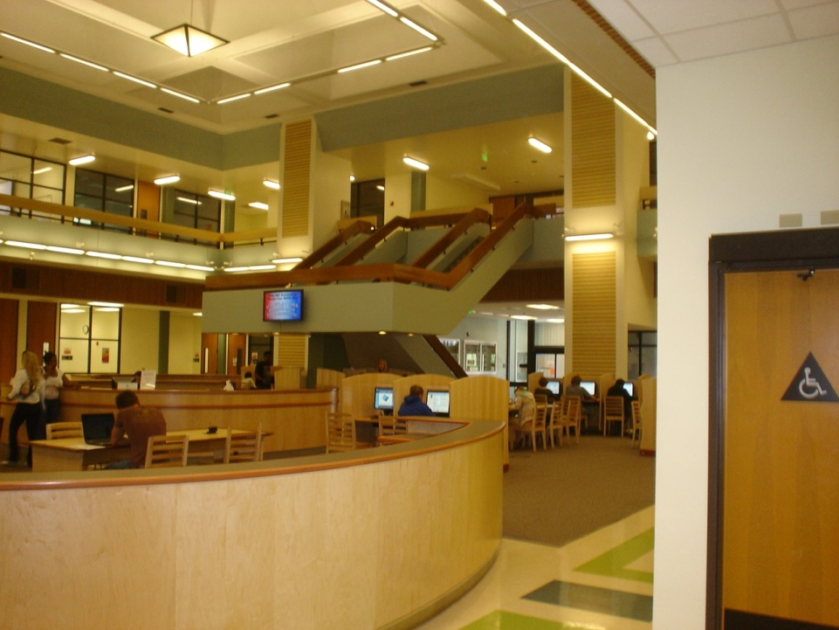
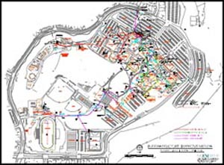
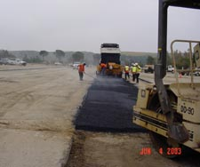
Moorpark College
Learning Resources and Telecommunications Building
Budget $5.4 million
Completed 2005
Library Renovation
.
Budget $6.8 million
Completed 2007
Campus Electrical System Upgrades
Budget $8.5 million
Completed 2010
Parking Lot Renovations
Budget $2.3 million
Completed 2003

Slide 5
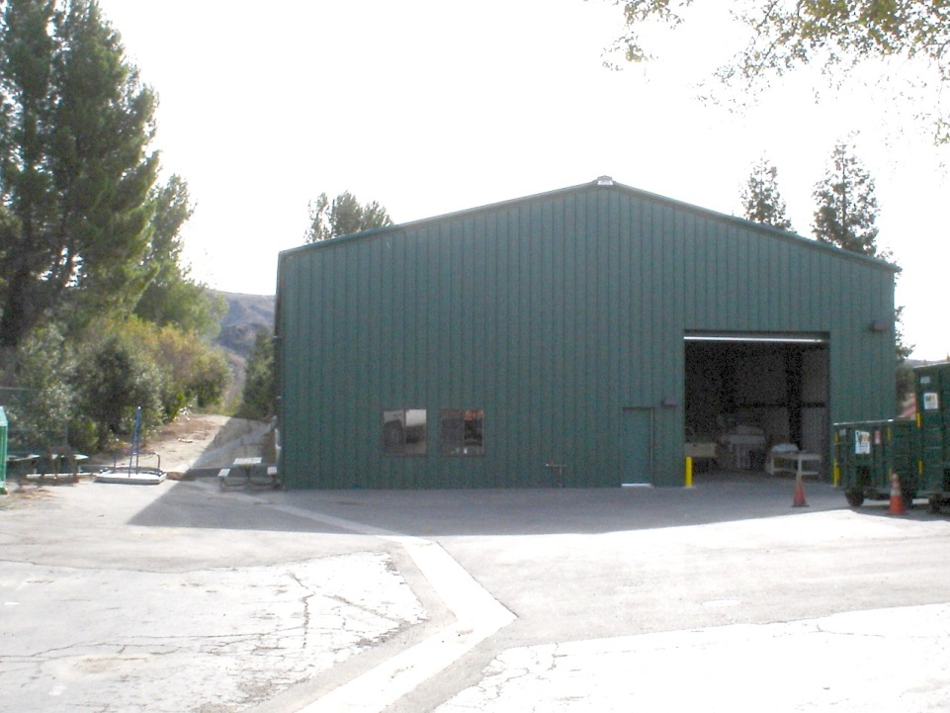
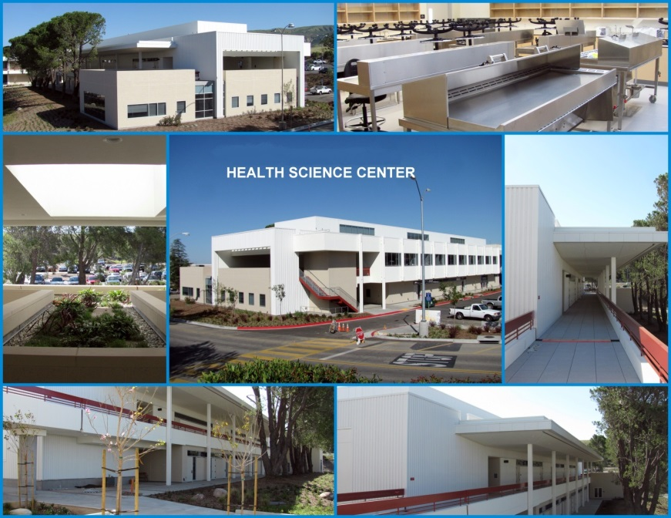
Moorpark College
Maintenance and Operations Warehouse
Budget $1 million
Completed 2006
Health Science Center
Budget $15 million
Completed 2007

Slide 6
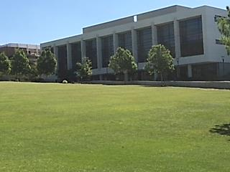
Moorpark College
Academic Center
Budget $24.1 million
Completed 2010

Slide 7
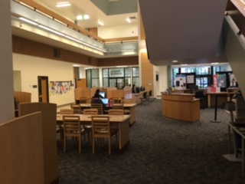
Moorpark College
One
Stop
Shop
Budget $2.7 million
Completed 2014

Slide 8
Moorpark College
EATM
Teaching
Facility
Budget $13.1 million
Completed 2011

Slide 9
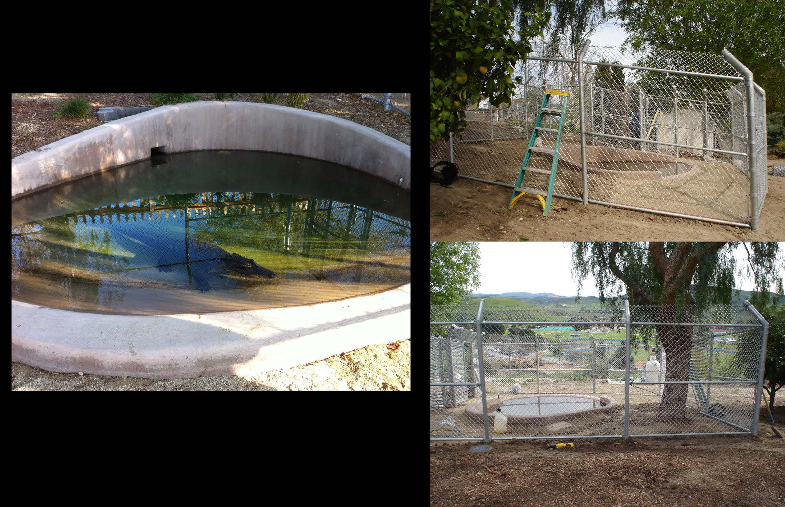
Alligator Enclosure

Slide 10
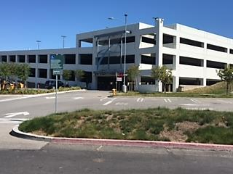
Moorpark College
Parking Structure
Budget $16.2 million
Completed 2014

Slide 11
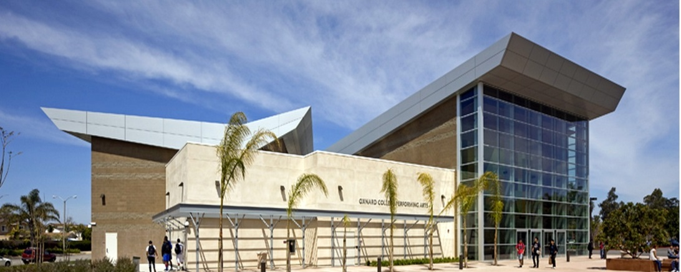
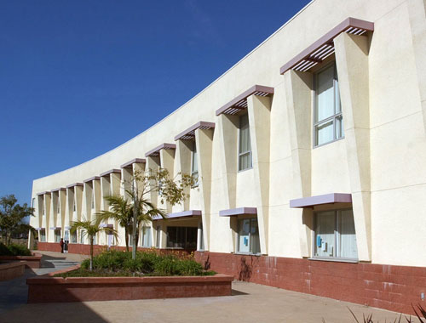
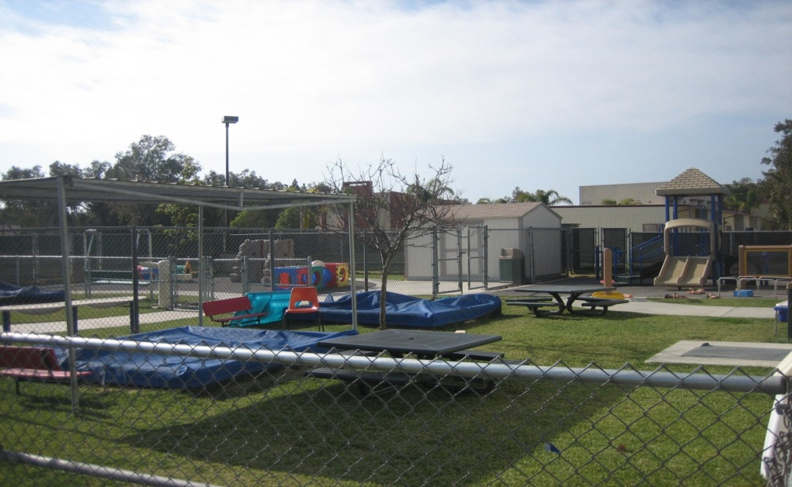
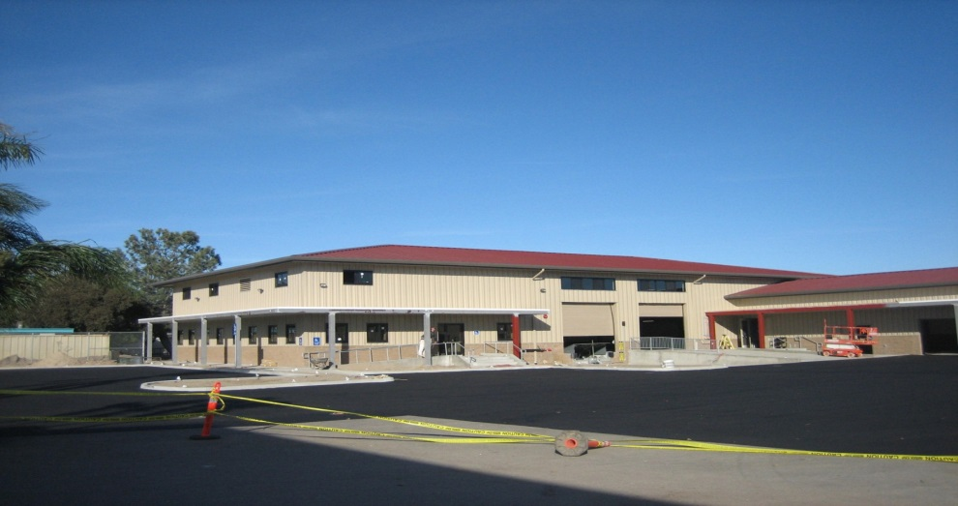
Oxnard College
Performing Arts Center
Budget $16.55 million
Completed 2010
Community/Student Service Center
Budget $1.9 million
Completed 2003
Child Development Center
Budget $1.5 million
Completed 2004
Maintenance Warehouse
Budget $1.32 million
Completed 2005

Slide 12
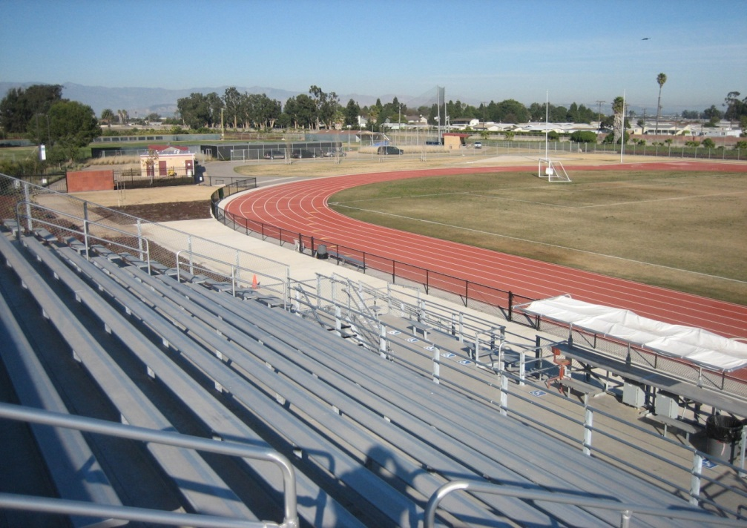
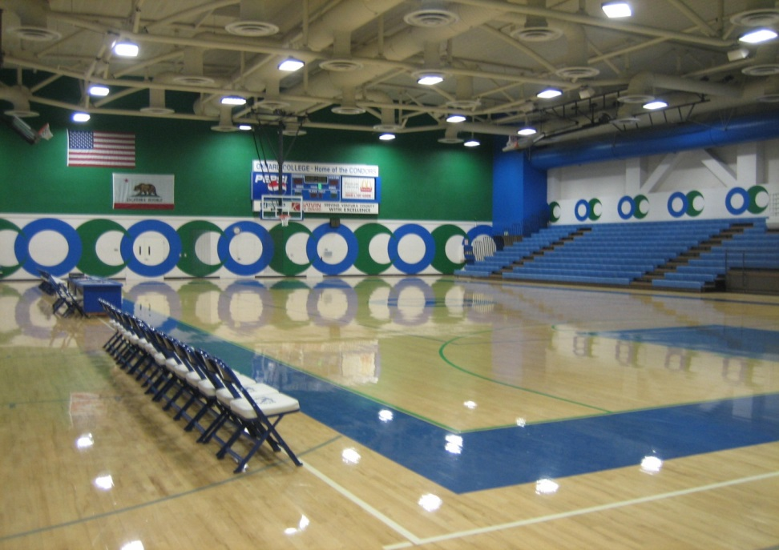
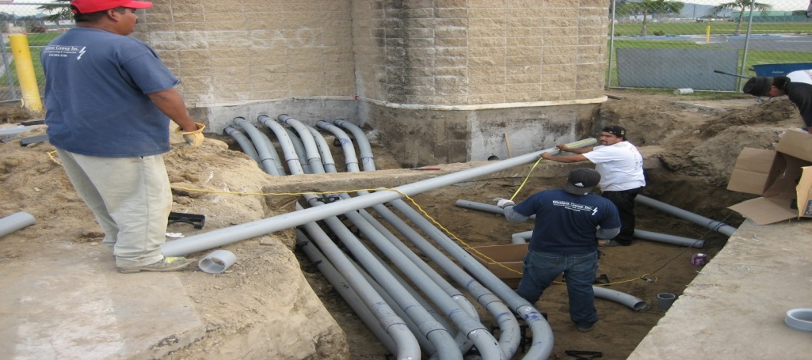
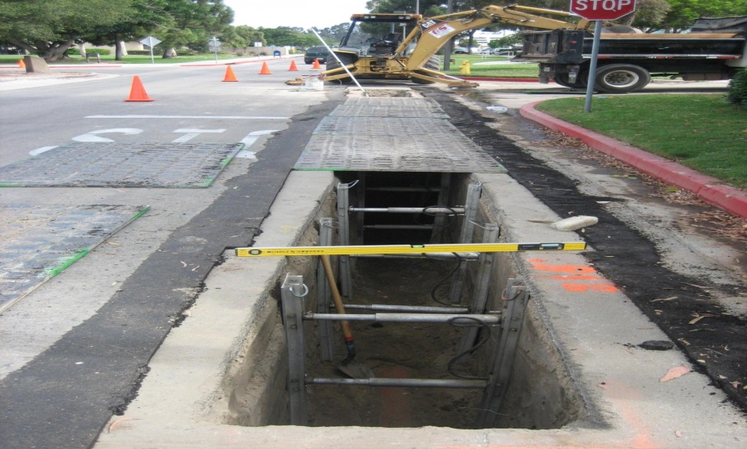
Oxnard College
New Track and Soccer Fields, Bleachers, and Softball fields
Budget $8 million
Completed 2006
Gymnasium Renovations
Budget $1 million
Completed 2005
Campus Electrical System Upgrades
Budget $3 million
Completed 2007
Piped Utilities System Upgrade
Budget $3.9 million
Completed 2007

Slide 13
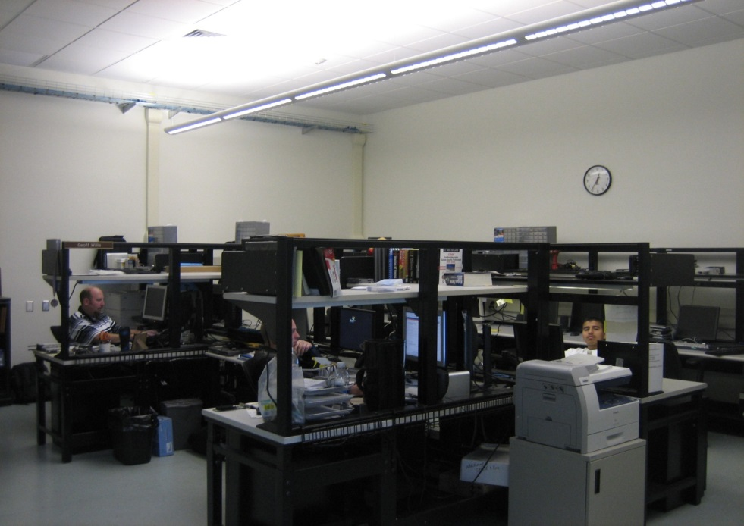
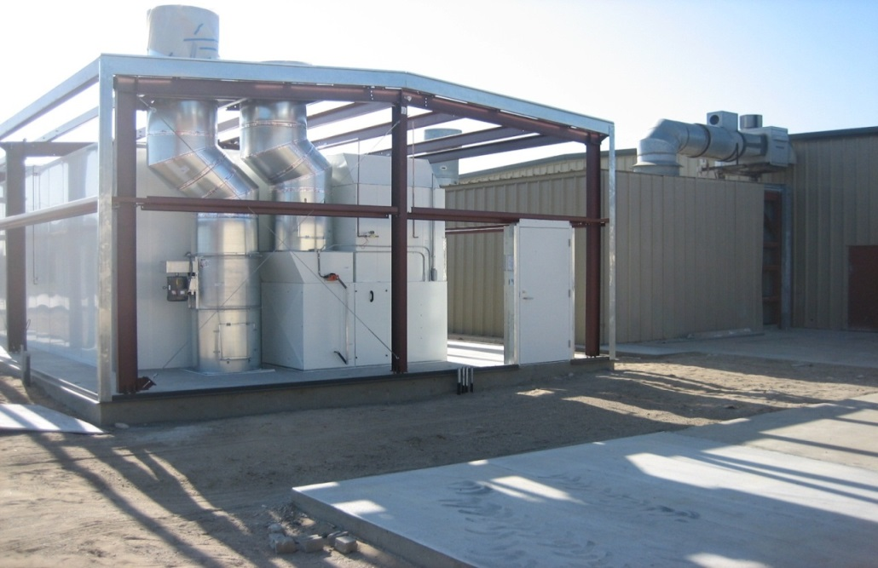
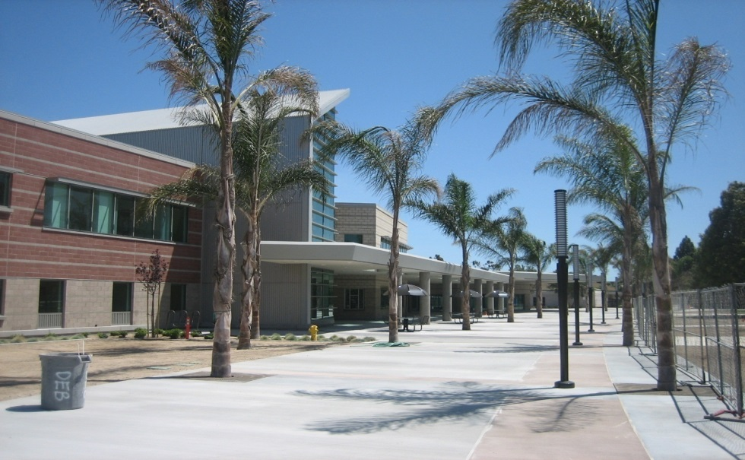
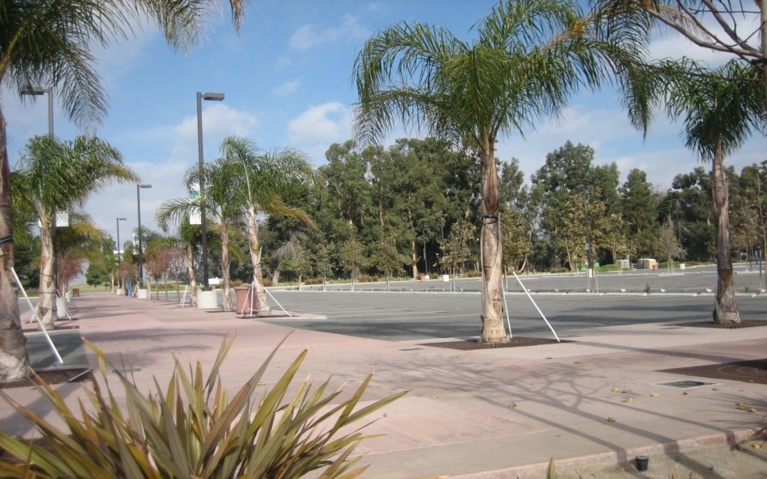
Oxnard College
Library MDF Telephone Renovations
Budget $800,000
Completed 2007
Auto Technology Project
Budget $1.4
Completed
Student Service Center
Budget $28 million
Completed 2009
North Parking Lot and Storm Drain Improvements
Budget $4 million
Completed 2005

Slide 14
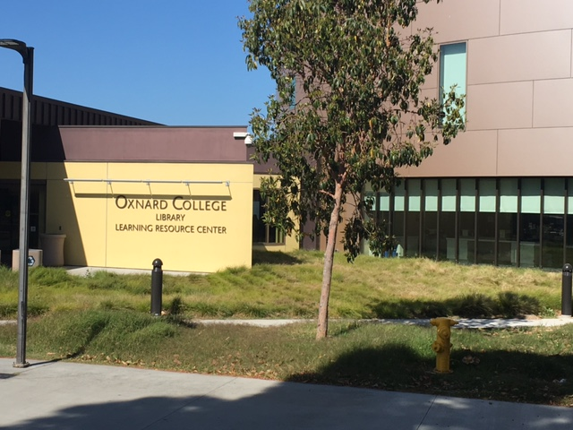
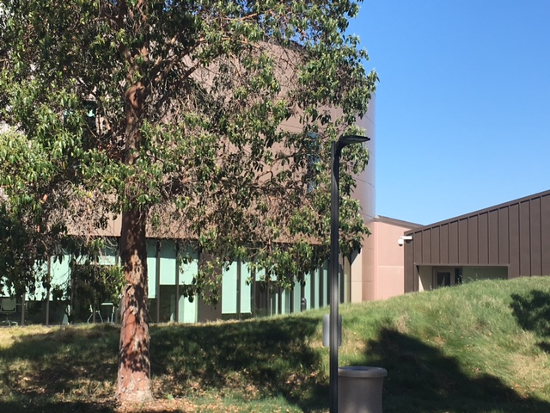
Oxnard College
Library/LRC Expansion
Budget $16 million
Completion 2013

Slide 15
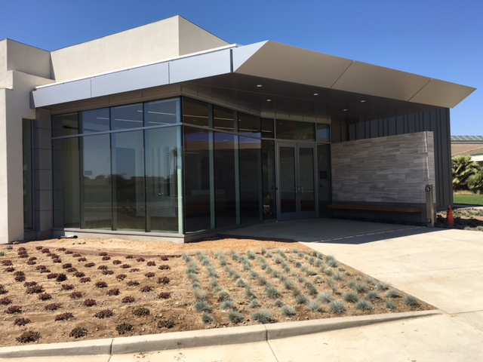
Oxnard College
Dental Hygiene Exterior
Budget: $8.1 million
Completion: June 2016

Slide 16
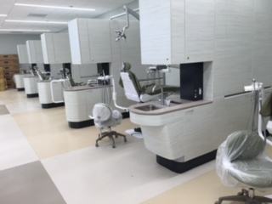
Oxnard College
Dental Hygiene Interior

Slide 17
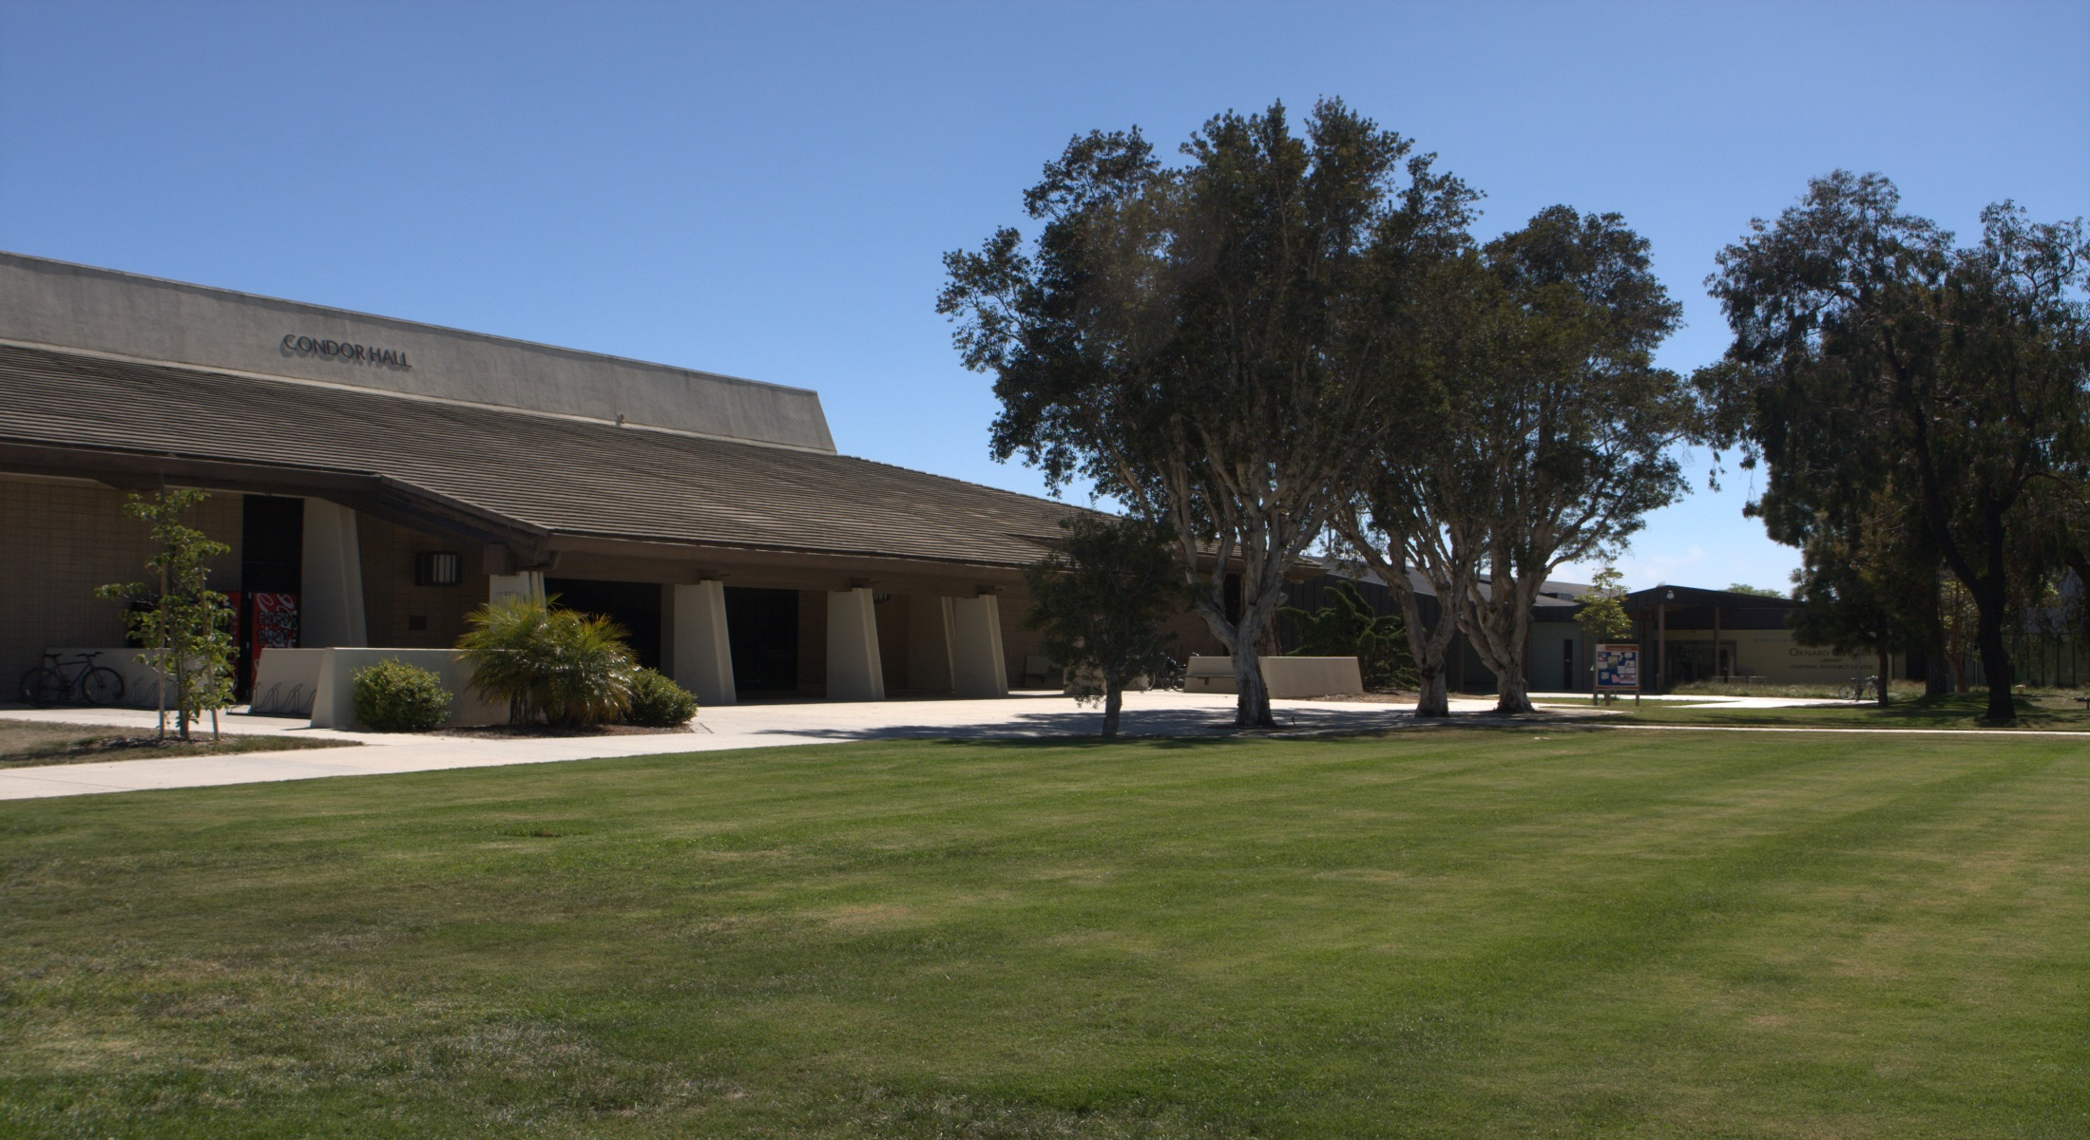
Oxnard College
LRC Reno. and Seismic Upgrades
Budget $9 million
Completion August 2016

Slide 18
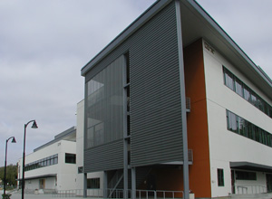
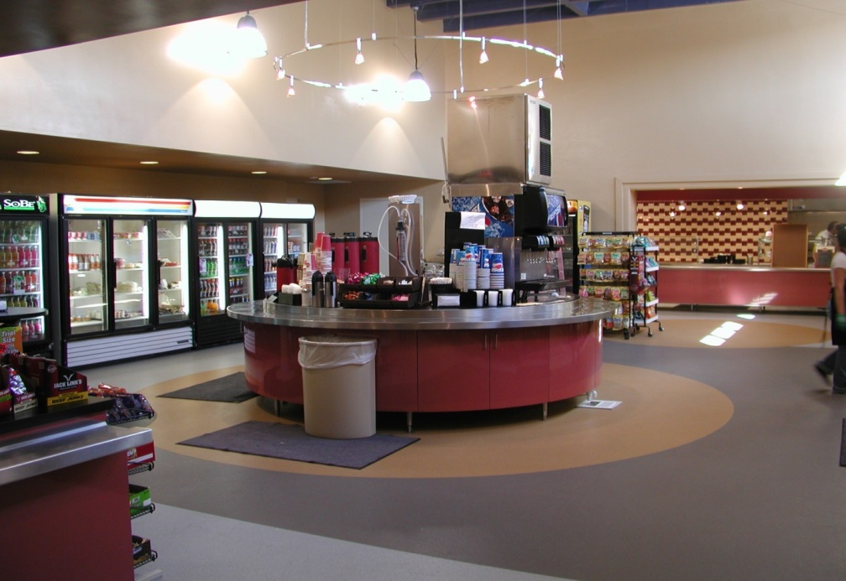
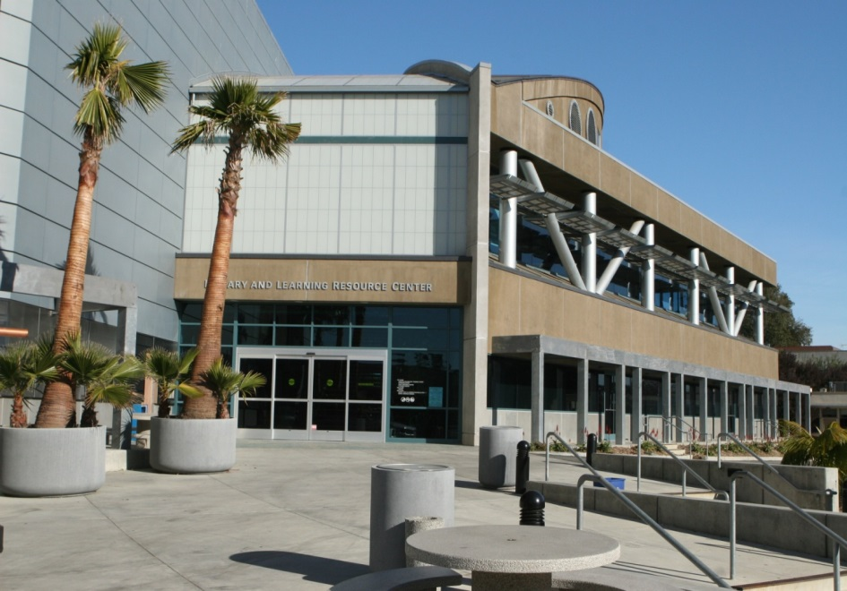
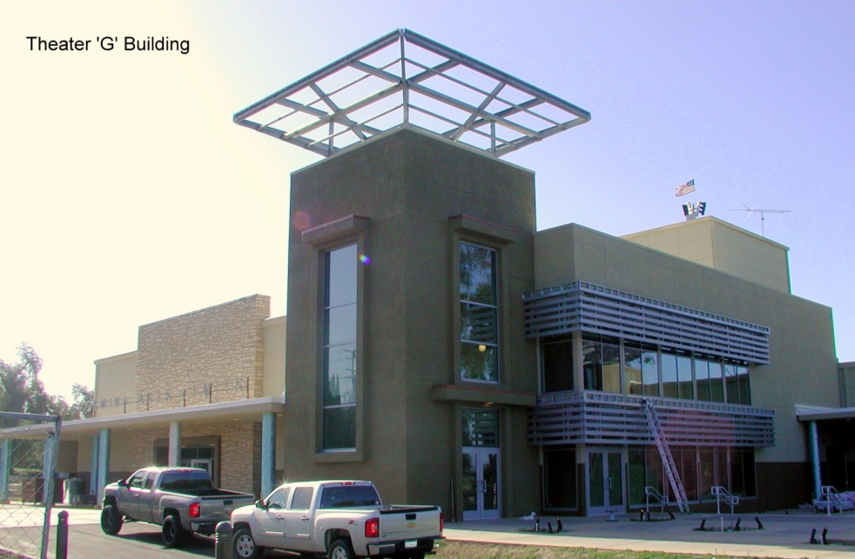
Ventura College
Advanced Technology Education, General Purpose, Health Science Classrooms
Budget $46 million
Completed 2009
Renovation of Food Services
Budget $2.1 million
Completed 2007
Learning Resources Center
Budget $2.9 million
Completed 2005
Theater
Budget $16.5 million
Completed 2012

Slide 19
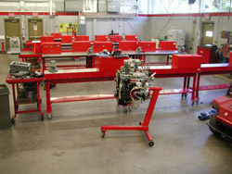
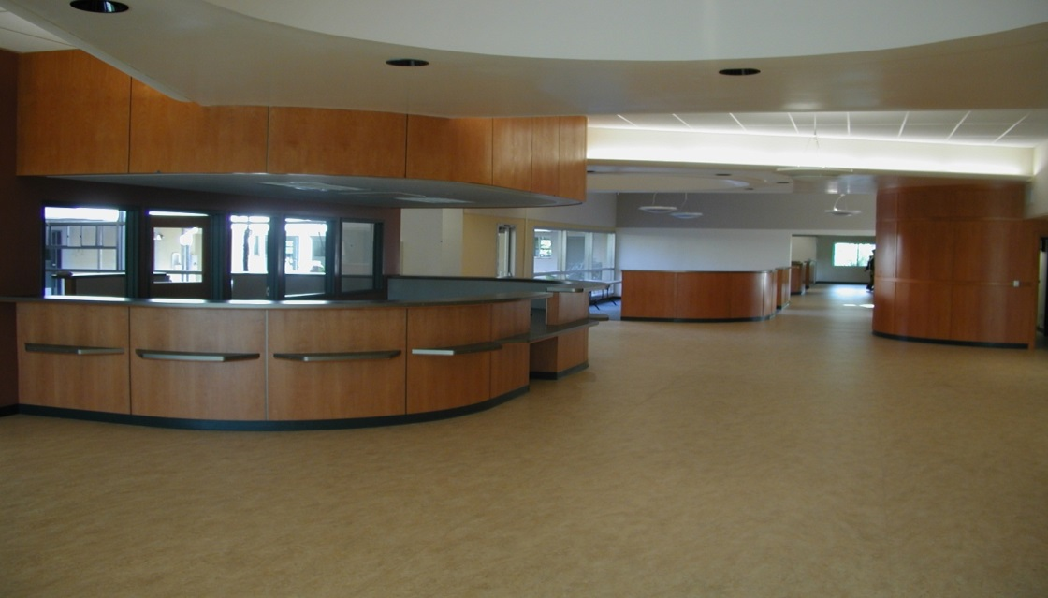
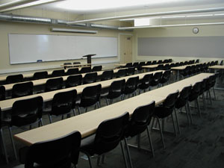
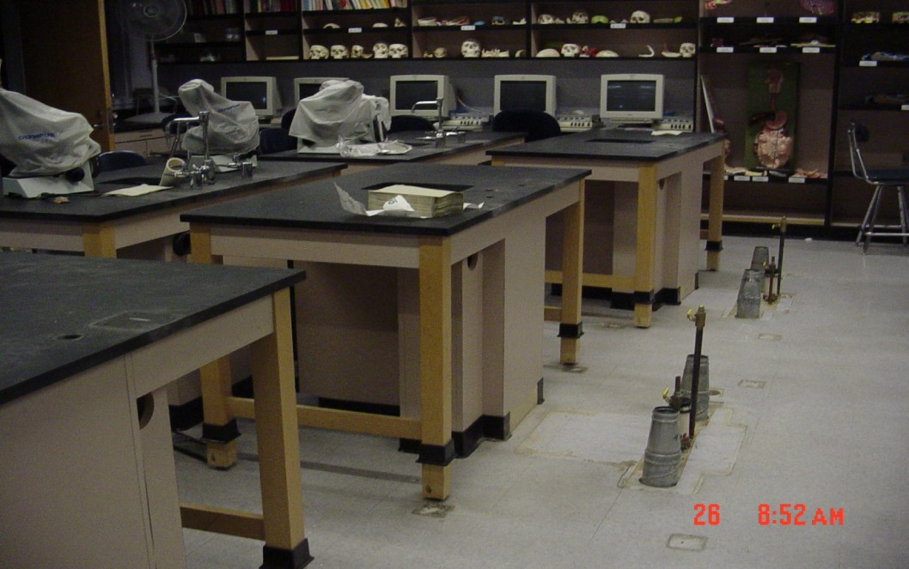
Ventura College
Renovations (Building S)
Budget $4.76 million
Completed 2011
Renovation of Building D (Student Services Center)
Budget $4.9 million
Completed 2007
Renovation to Communications Building (F)
Budget $425,000
Completed 2007
Science Building Upgrades
Budget $185,000
Completed 2004

Slide 20
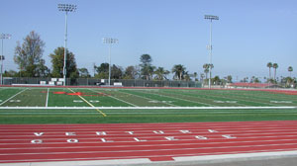
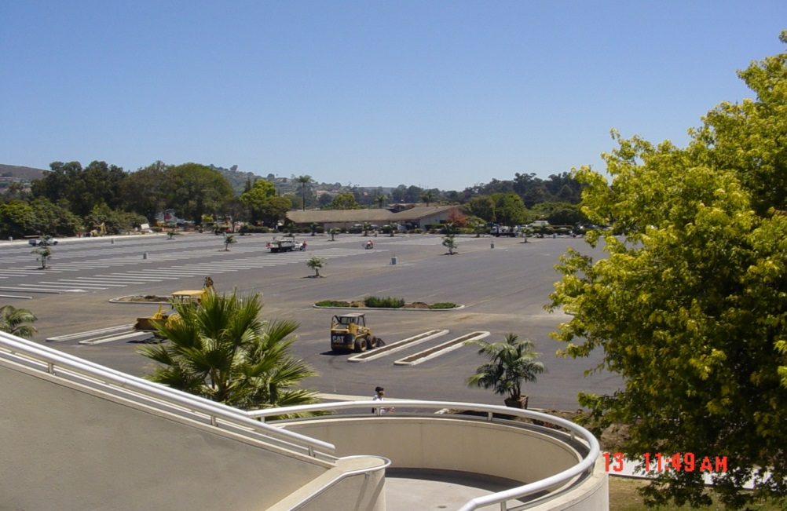
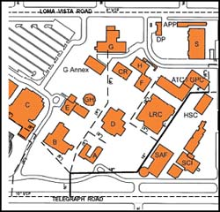

Ventura College
New track, fields, concession, new scoreboard, exterior bleachers, restroom facilities
Budget $10.7 million
Completed 2007
East Parking Lot Renovation
Budget $1.65 million
Completed 2004
Campus Lighting System Upgrades
Budget $909,000
Completed 2006
Piped Utilities System Upgrade
Budget $380,000
Completed 2012

Slide 21
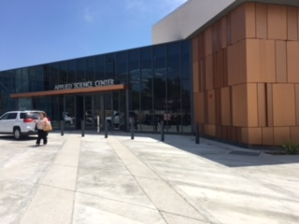
Ventura College
Applied Science
Budget: $15 Million
Completion: May 2016

Slide 22
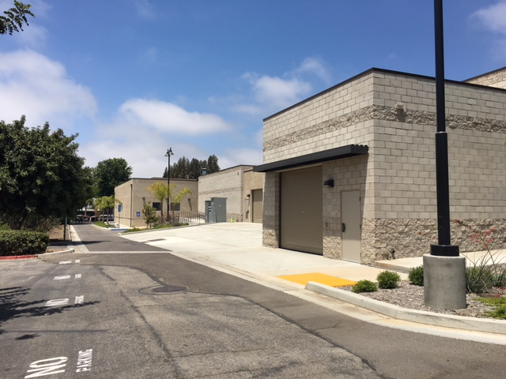
Ventura College
Renovate Maintenance and Operations
Budget $5.3 million
Completion 2015

Slide 23
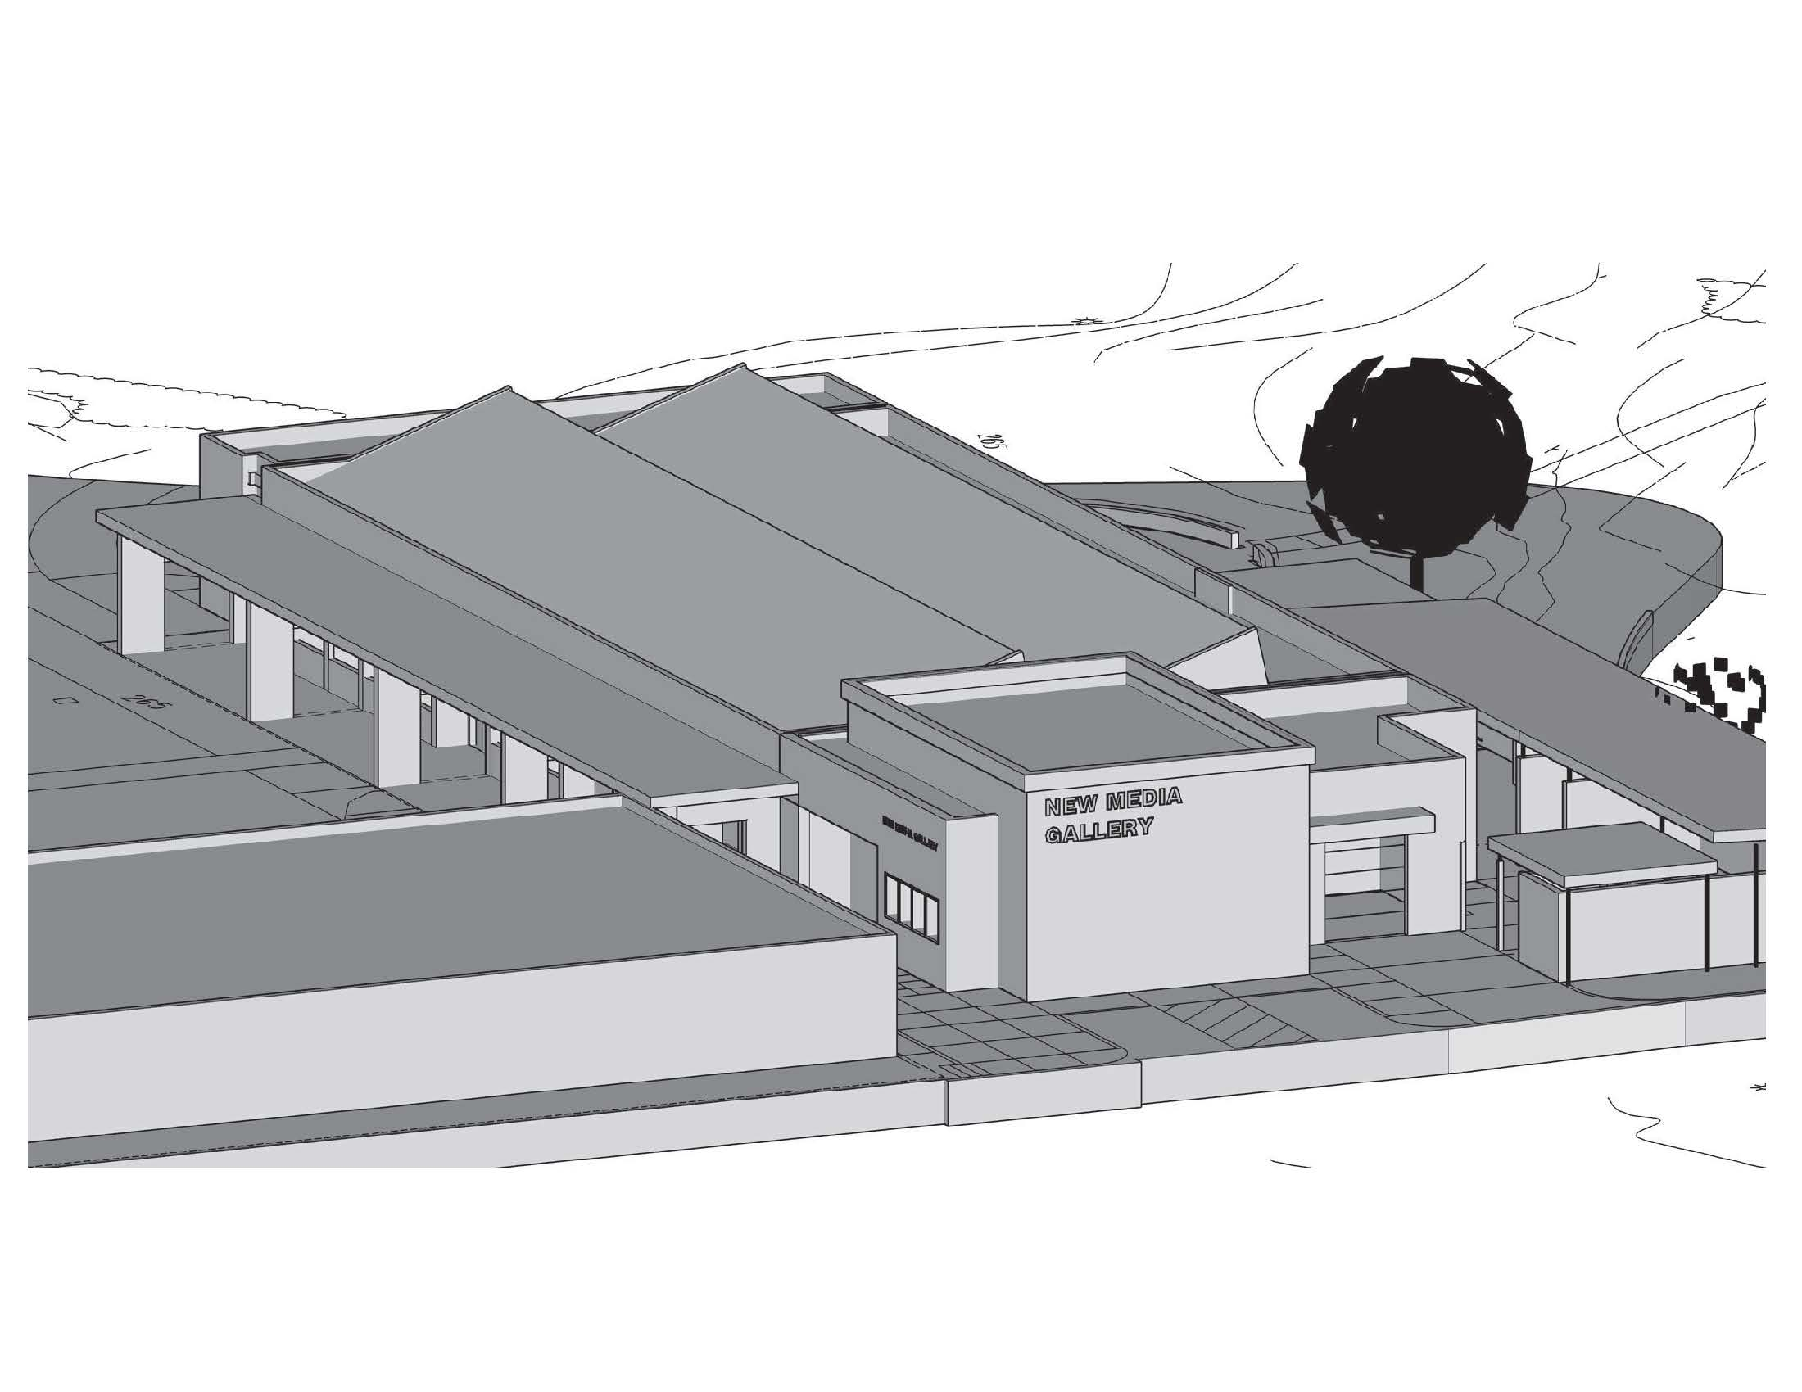
Ventura College
Renovate Studio Arts Building
Budget $6.2 million
Completion June 2016

Slide 24
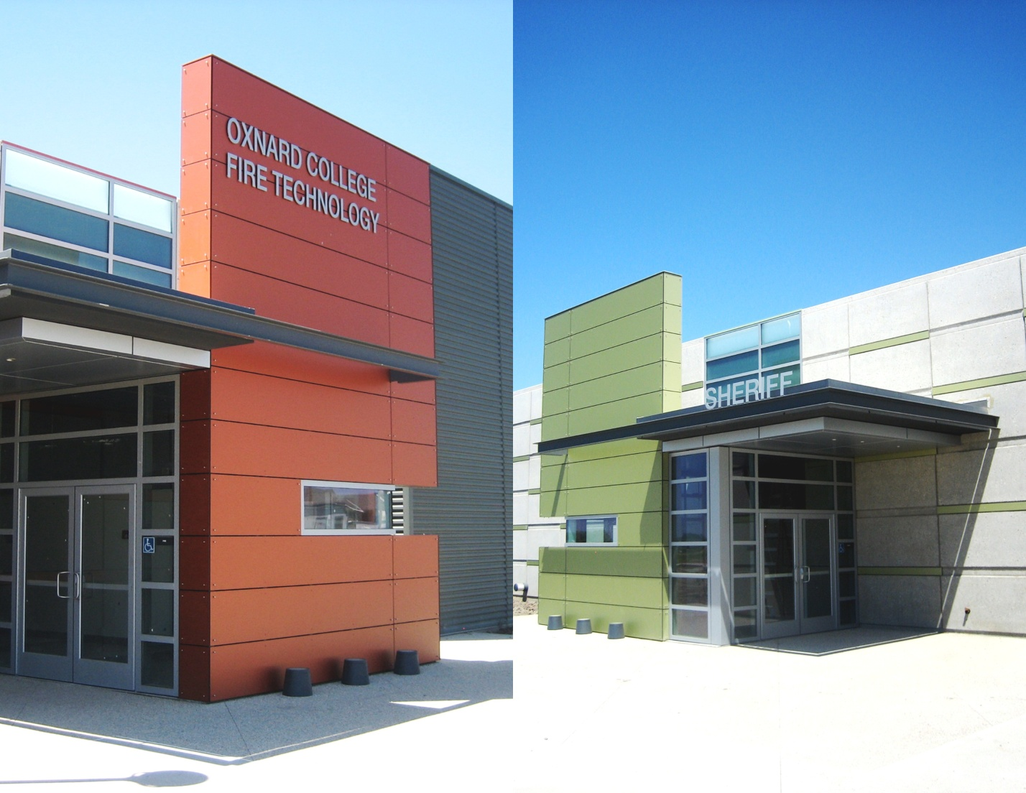
Camarillo Property
Fire, Sheriff & Police Education Training Academy
Budget $25 million
Completed 2011

Slide 25
Camarillo Property
Completed Projects Overview
Phase II environmental reports
Application to the State Department of Toxic Substance Control (DTSC) for cleanup of the TCE plume
Demolition of the old bunkers, including recycling the concrete for use at other VCCCD locations
Grading work for the Regional Fire, Sheriff & Police Education and Training Academy
Radiation Testing
Electrical & Telephone System Upgrades

Slide 26
Conclusions

Slide 27
VCCCD Bond Spending

Slide 28
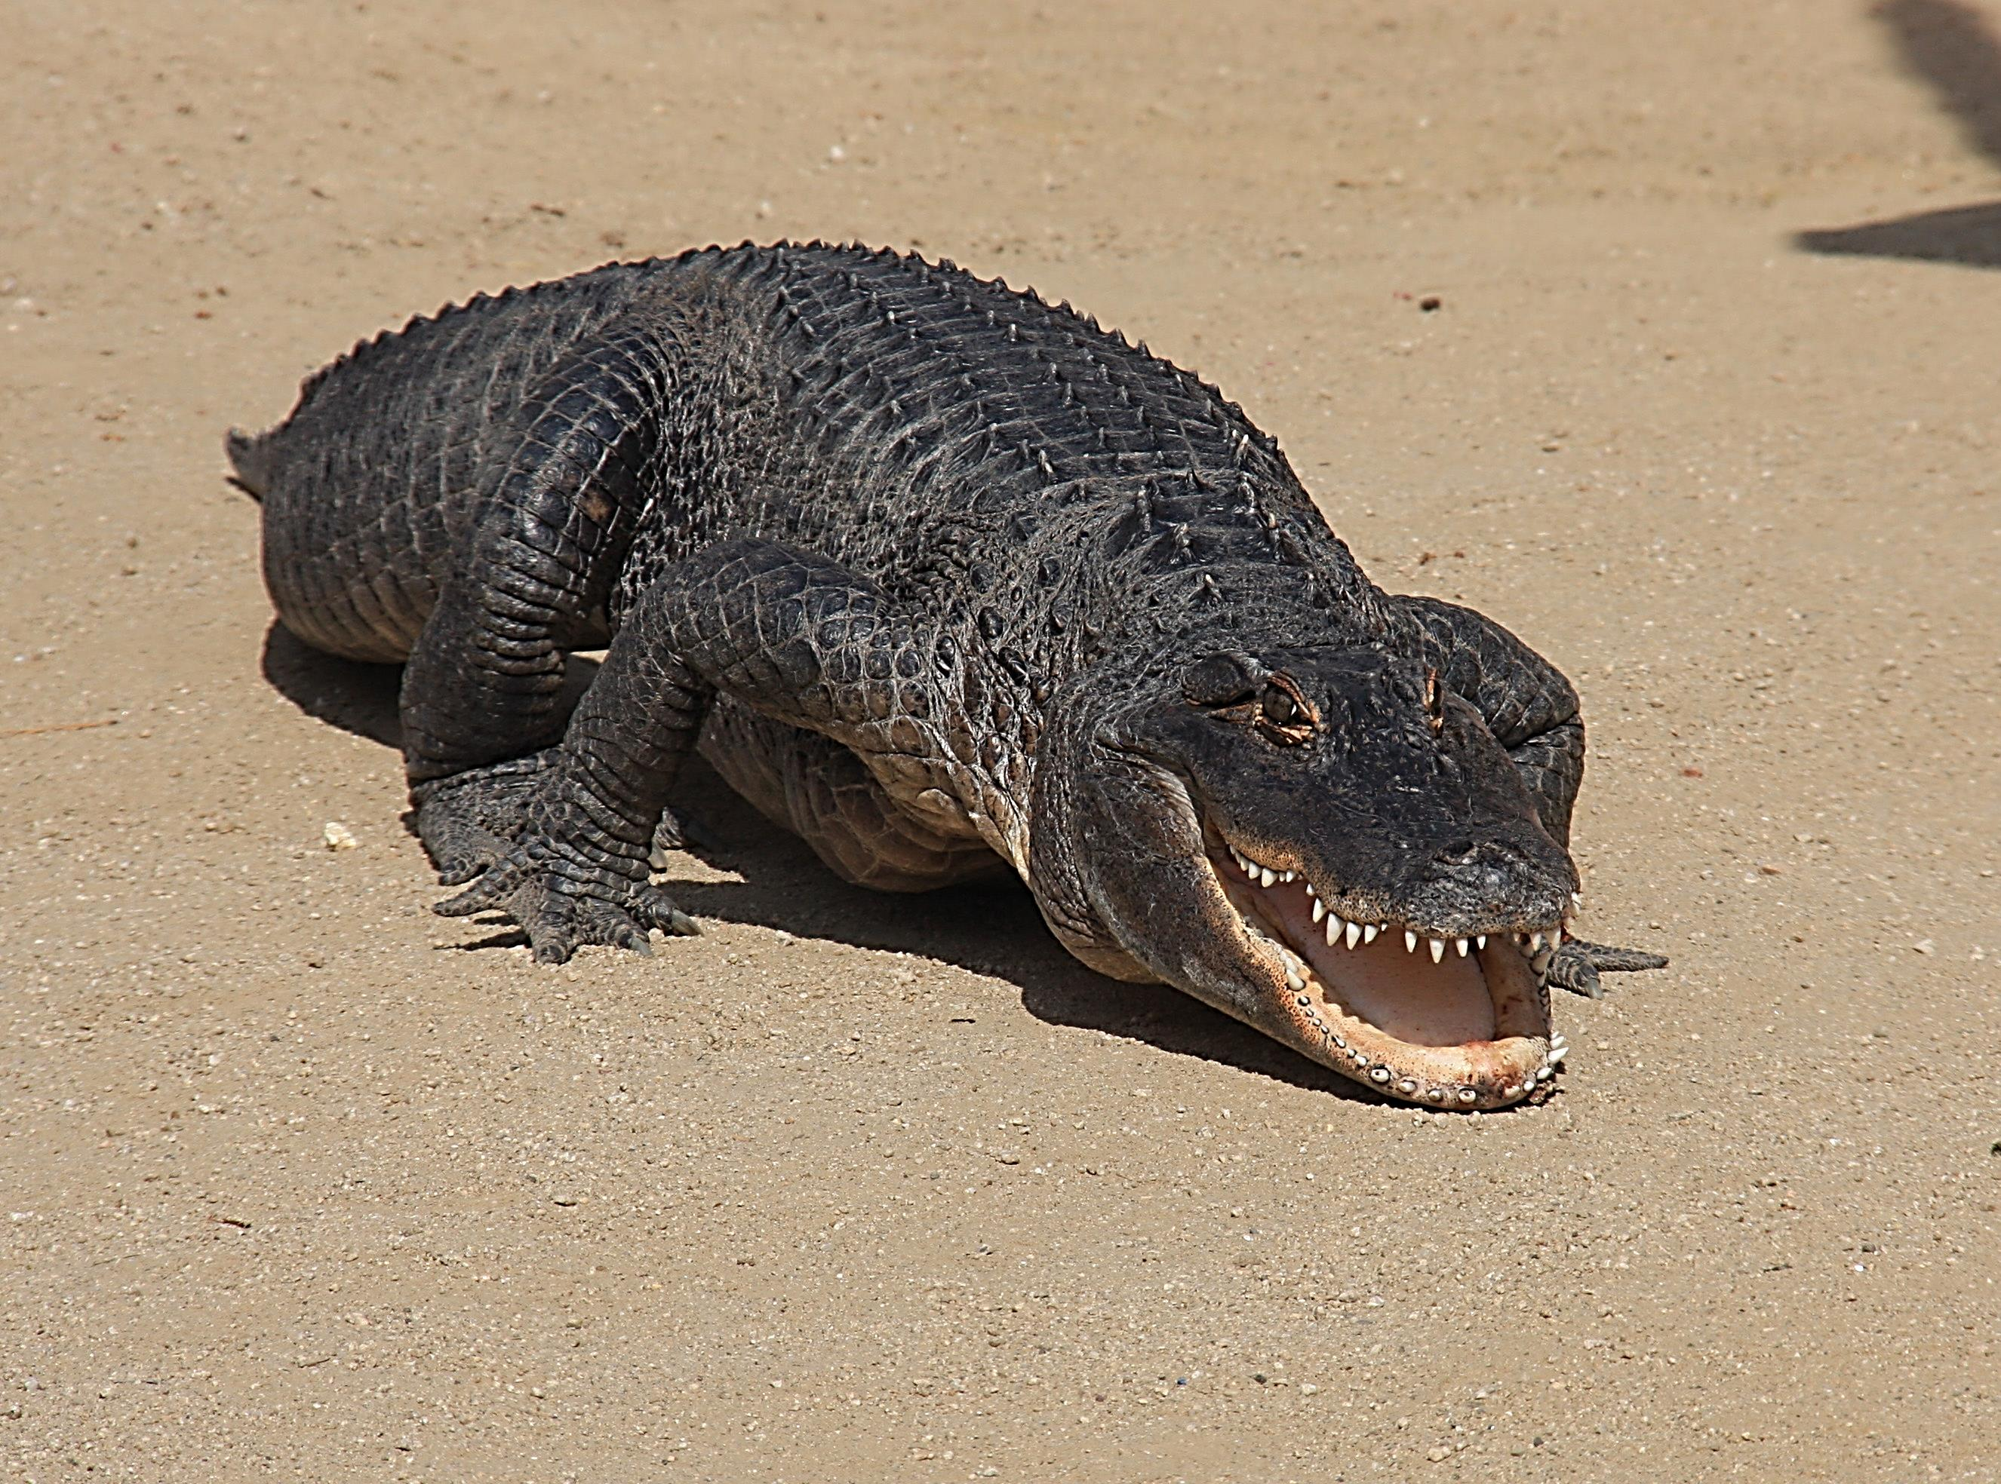
Thanks for a Job Well Done!
I’m Happy!
Happy the Alligator

